Slide 1
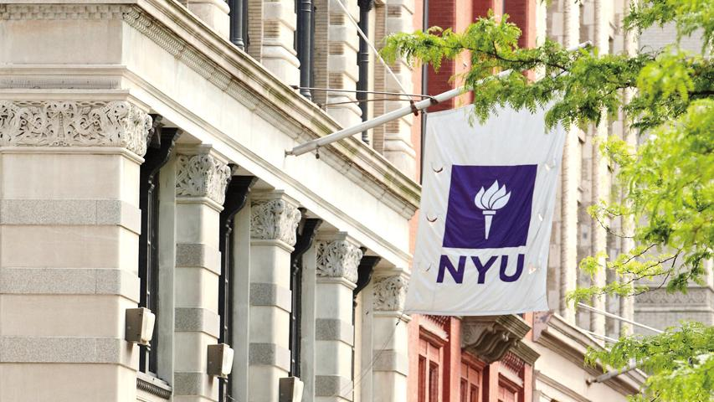

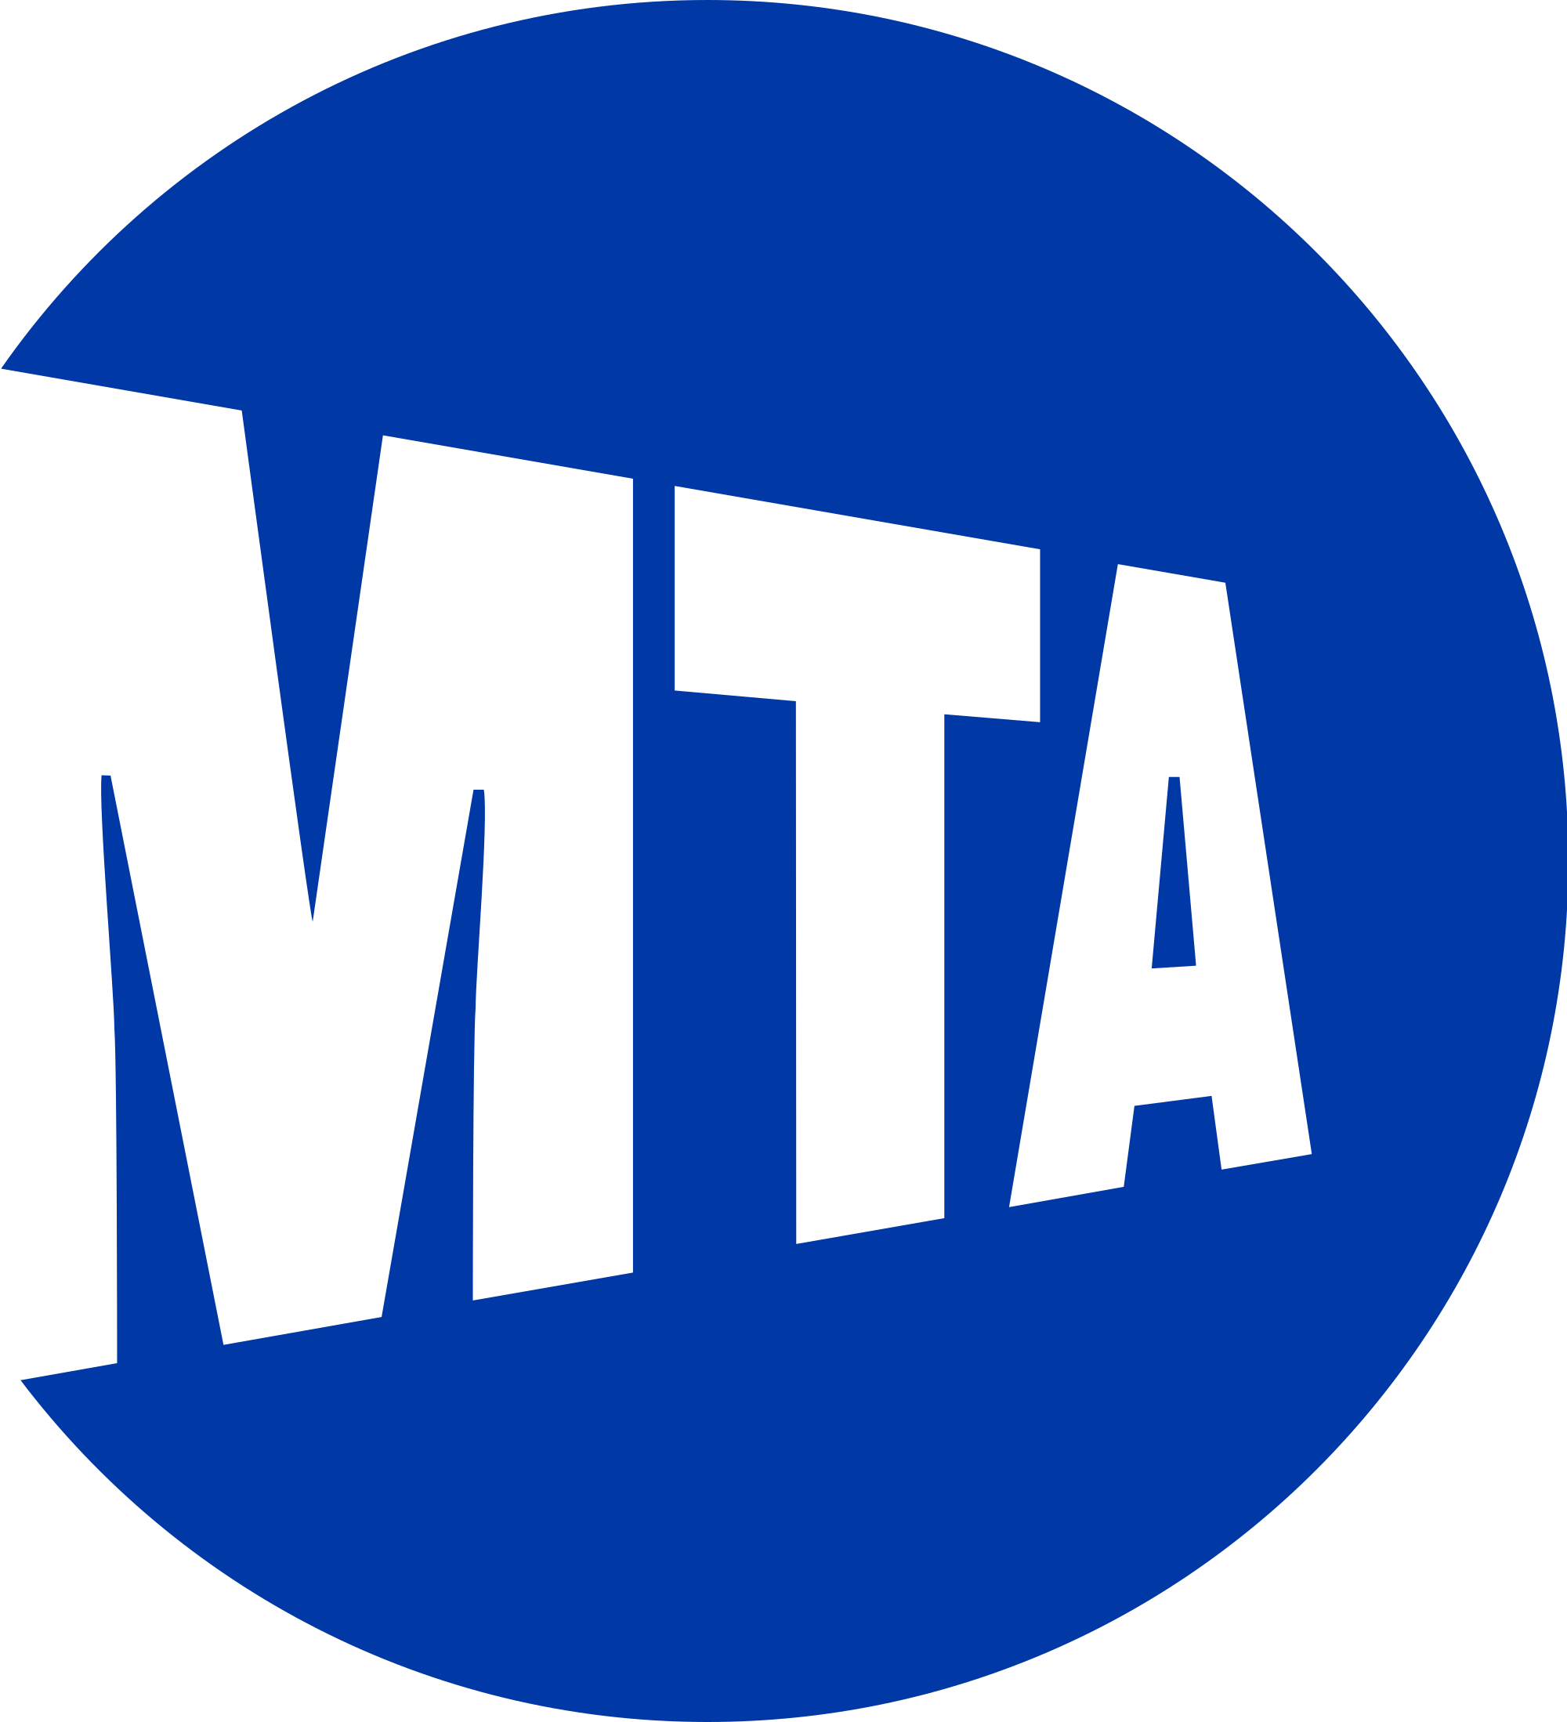
Biometric Access System for MTA Services
Research Study
Submitted by –
Anirudh Dave
Dhananjay Atree
Disha Thakkar
Navneet Poddar
Pallavi Varandani

Slide 2
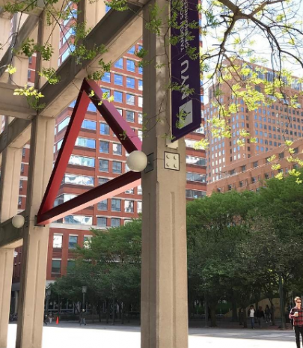
Agenda:
Introduction
Problem Statement
Previous Attempts
Proposal
Feasibility

Slide 3
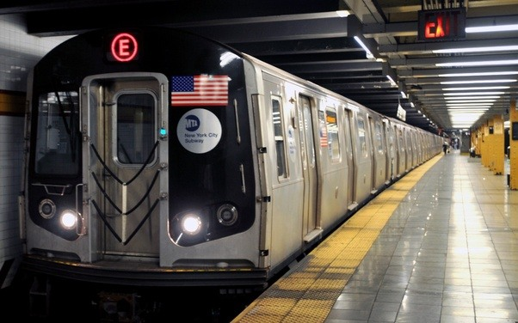
Biometrics at M.T.A, New York City
Introduction
A snapshot of the public transit industry in the US:
Industry revenue - $74.9 billion
Industry profit - $4.3 billion
Annual growth rate 2.5% (2013-2018)
Growth rate will be halved to 1.2% by 2023.
*
3

Slide 4
Biometrics at M.T.A, New York City
It is unfair to point to industry revenue as a performance indicator.
With 86% of the total transit system is comprised of heavy rail and buses
Necessary to understand key elements that will keep this system relevant in the eyes of the public.
New York’s Metropolitan Transportation Authority (MTA) is no exception.
*
4

Slide 5
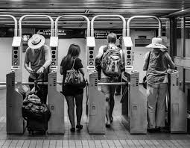
Biometrics at M.T.A, New York City
Problem Statement
“I lost my MetroCard”/”Where is my card?”
‘Swipe Again’
Plastic waste
Delay at Turnstiles
Anti-social elements
*
5

Slide 6
Biometrics at M.T.A, New York City
Current systems
Some systems use a hybrid of tokens and cards depending on type of passenger
The swipe card is currently the standard at the MTA and a popular access tool across the globe
Tap cards implementing NFC technology are slated to be the next all-in-one solution
These cards use smart chips which also double as banking solutions
Insecure method of access
Involves carrying a card either way
Currently can hold only small amounts of money as balance with banks
Loss can lead to a long wait for a replacement
*
6

Slide 7
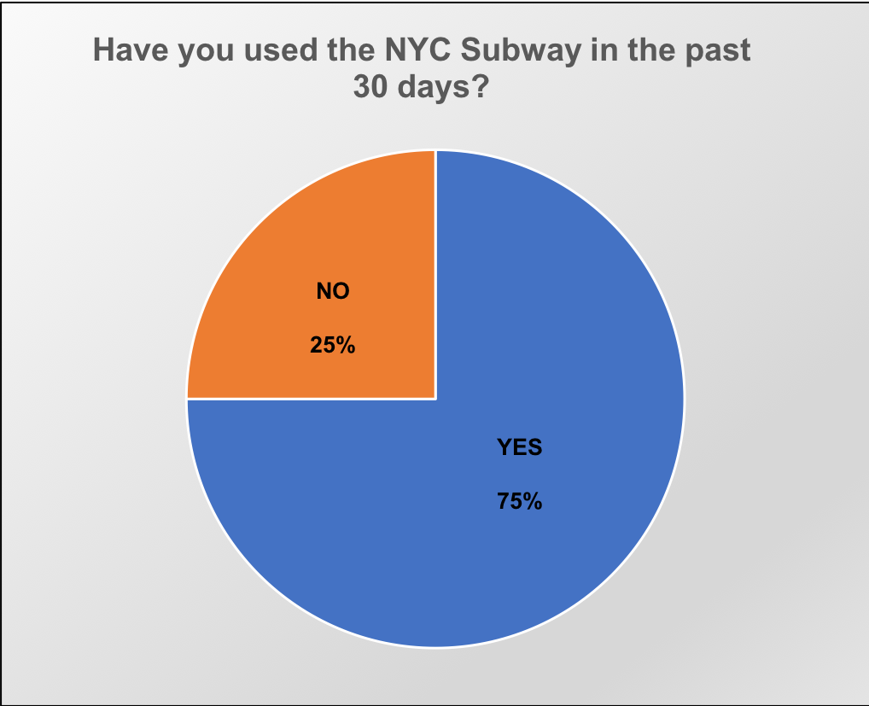
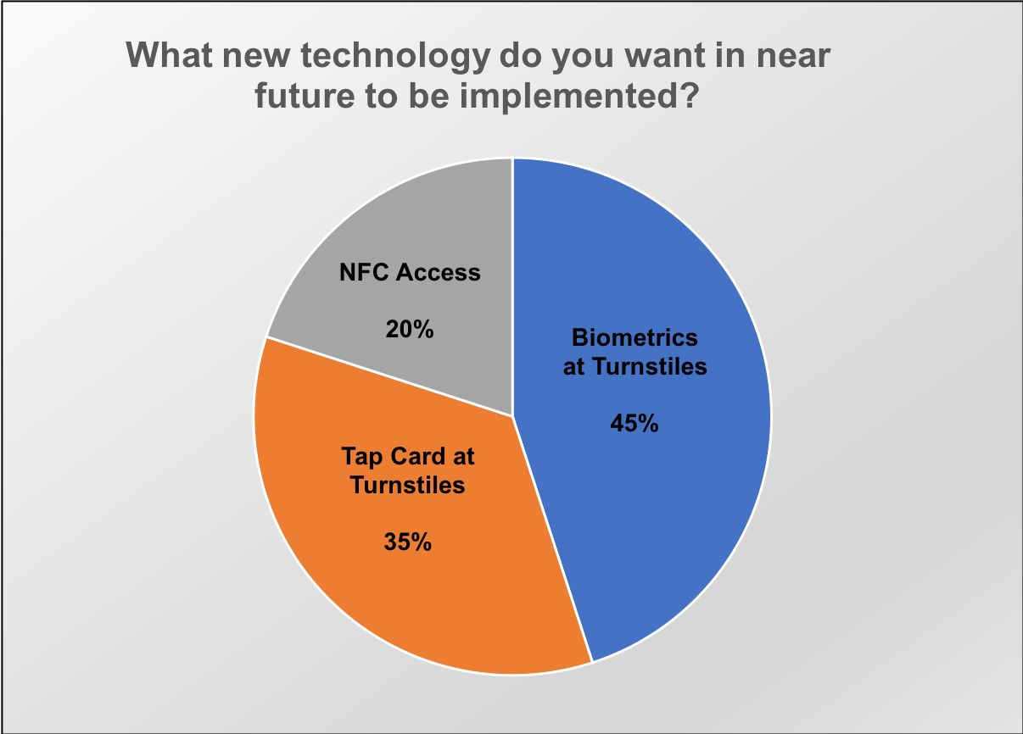
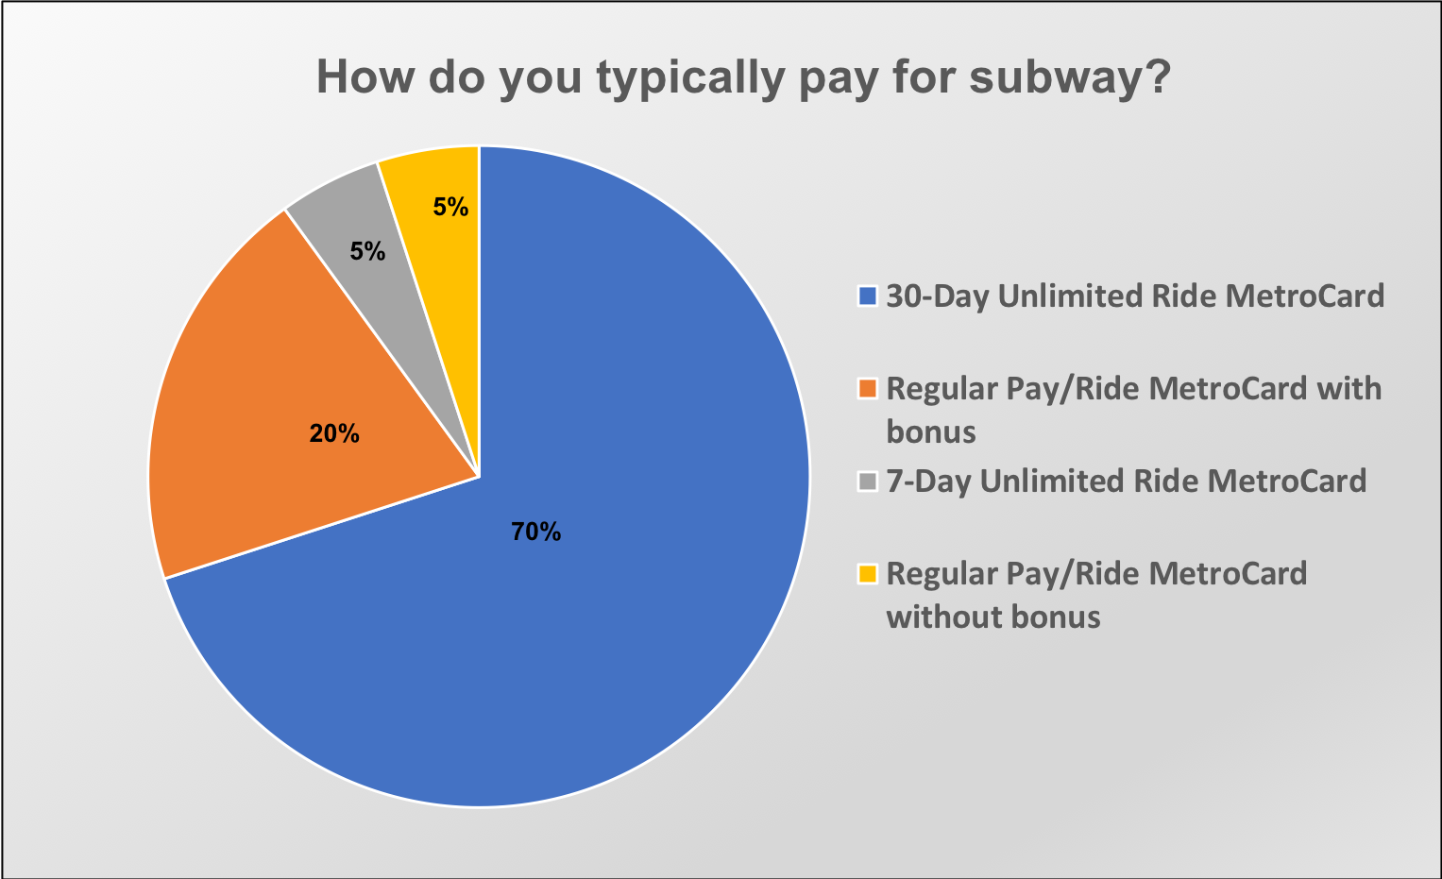
Biometrics at M.T.A, New York City
Survey Results
*
7

Slide 8
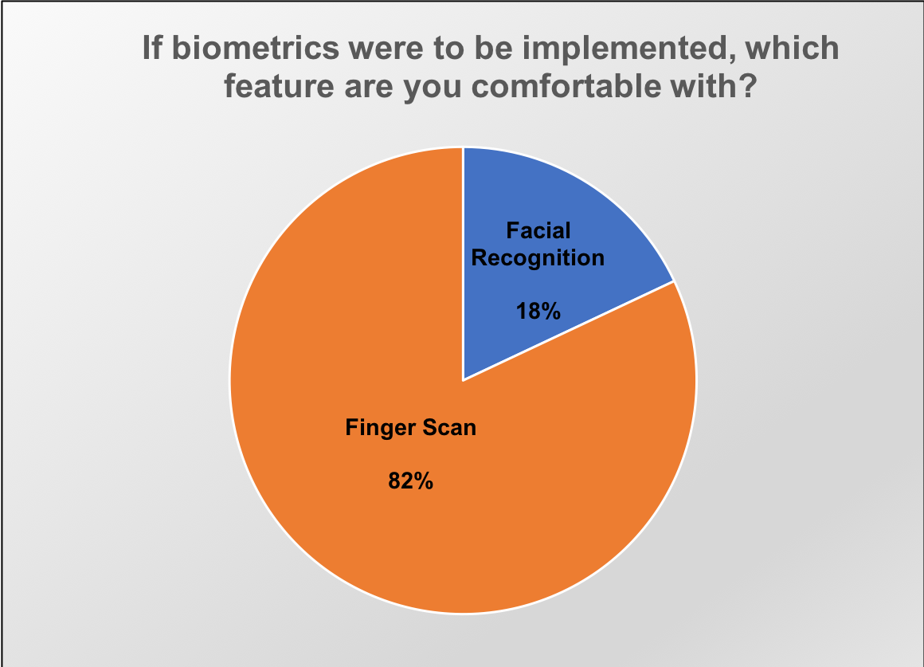
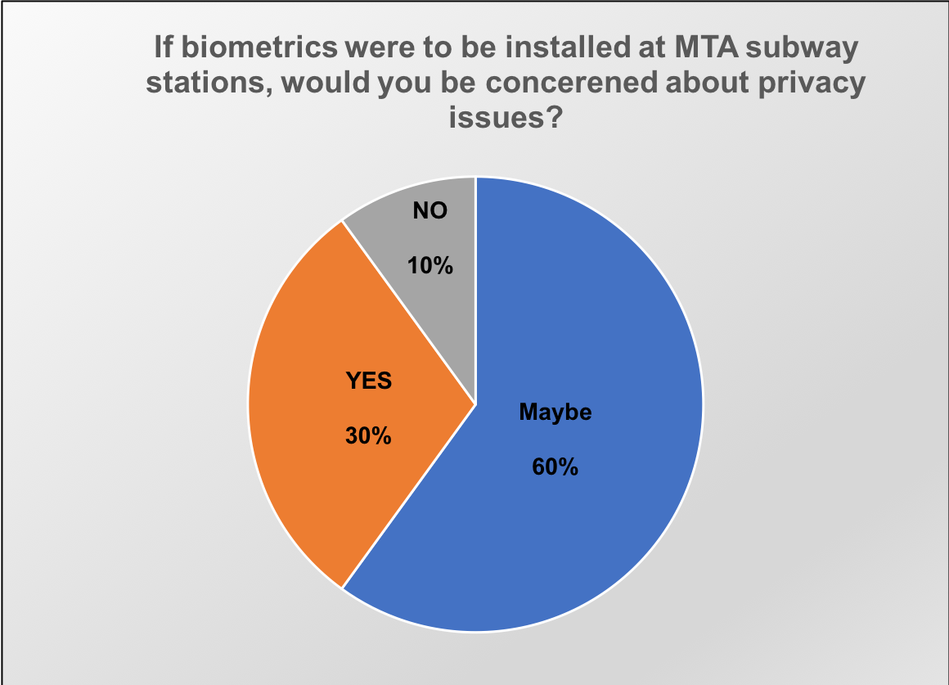
Biometrics at M.T.A, New York City
*
8

Slide 9
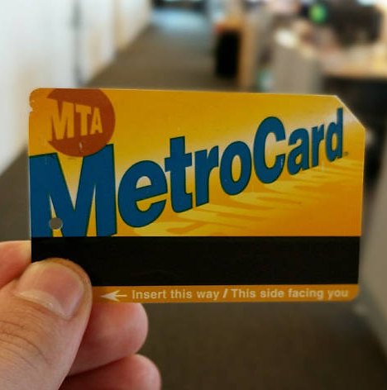
Biometrics at M.T.A, New York City
Evolution of ticketing system
The MTA started out with issuing physical tickets per passenger
It later allowed cash to be used directly for access
Tokens standardized the process due to engineering difficulties related to accepting coins
*
9

Slide 10
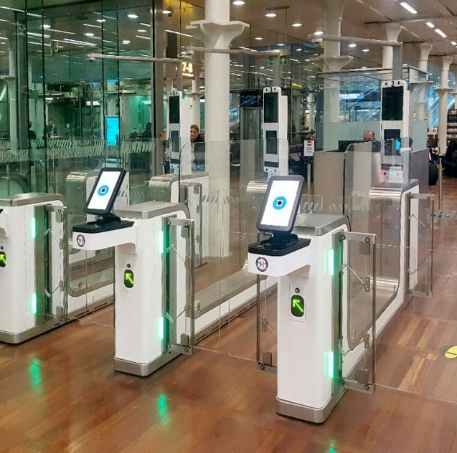
Biometrics at M.T.A, New York City
Proposal
MTA should move to biometric as a step toward card-less system
Types of Biometrics:
Multimodal
Unimodal
A gradual phase-out of the MetroCard in favor of biometrics
*
10

Slide 11
User registration process (Smartphone / MTA kiosk)
Full Name
Date of birth
Gender
Place of residence
Bank details
A secure unique code generated at the end of the process to help register fingerprint at the kiosk
First time fingerprint registration will take place only at the kiosk
Using MTA Android/iOS application a user can recharge their MTA account.
Biometrics at M.T.A, New York City
*
11

Slide 12
Biometrics at M.T.A, New York City
Underlying Infrastructure
The wire and wireless infrastructure will remain the same with the change at the user-end of card swipe device to fingerprint scanner.
The network base for security and faster authentication of the system will require an upgrade to high speed optic fibers as compared to traditional network base.
The distributed database system will require a change in the E-R schema of the system:
addition of a relation table - user information
User information linkage to the users travel history, balance history and current balance.
The unique code generated by the fingerprint scanner will act as a primary key.
*
12

Slide 13
Biometrics at M.T.A, New York City
Each fingerprint scanner will have a mathematical algorithm which reads the fingerprint and creates its equivalent unique code.
At each instance, the scanner generates the code of the print and matches with the primary key of the user database
This is followed by verifying the balance of the user.
The authentication will take no more than 5 seconds.
Future plan - With the help of machine learning algorithms the authentication process can be made quicker.
*
13
Notes:
Sanitizing wipes can be strategically placed around the fingerprint scanners to address hygiene issues.
Special cases where if a person is suffering from a disability that hinders the biometric scanning the system can let them access through a special ticket of travel which they can generate from the Kiosk. (or enter a unique identification code assigned to them on a per case basis. Generating tickets is not time efficient).

Slide 14
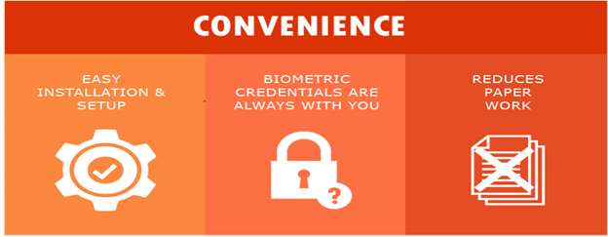
Biometrics at M.T.A, New York City
Feasibility
Major initial investments in time, effort and money to cater to 5 million daily passengers
Benefits:
Reduction in administrative costs.
Convenient accessibility
Hard to forge
Cut-down carbon footprint by eliminating the plastic MetroCard
Prevents anti-social elements
.
*
14

Slide 15
Biometrics at M.T.A, New York City
Financial feasibility for biometric system
Everyday Riders | Fare evasion losses (annually) including trains and buses | Average Installation charges of finger print machines (per station) | Average Installation charges of finger print machines (per bus) | Total number of subway station | Total number of buses | Total installation cost
Approx. 5 million | $55 million | $81000 | $2700 | 472 | 5700 | Approx. $65 million

Slide 16
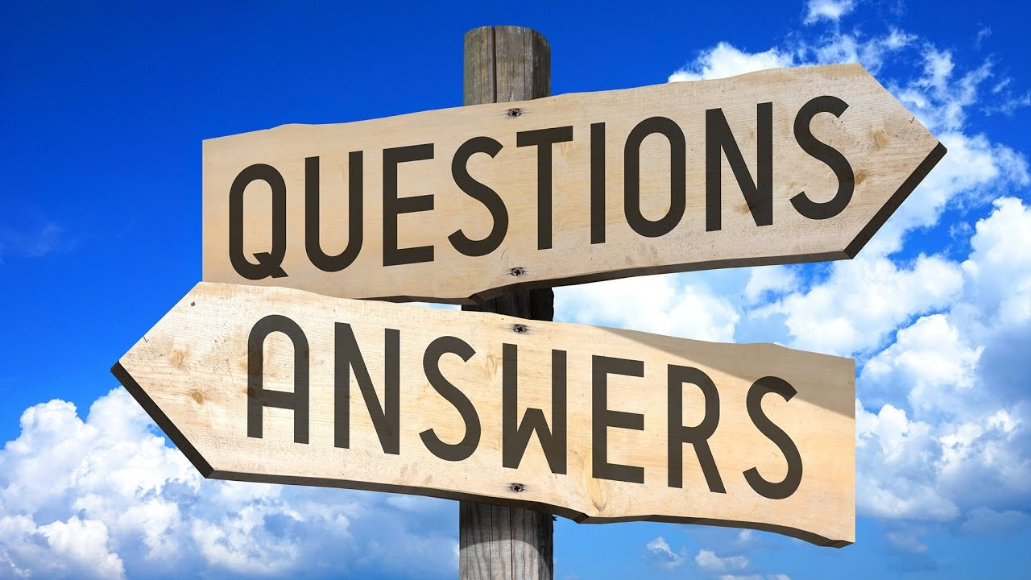
Biometrics at M.T.A, New York City
*
16

